Slide 1
Neuromorphic Computing & Hardware L4: SNN Training
Intelli-Chip Lab
Fall 2026

Slide 2
Objectives
After this lecture, students should be able to:
✓ Understand surrogate-gradient training
✓ Recognize tradeoffs between accuracy, latency and hardware efficiency

Slide 3
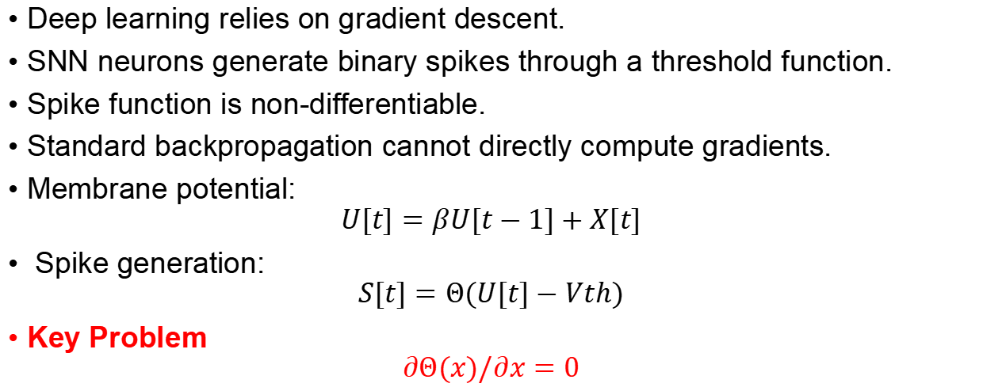
SNN Training Challenge
Deep learning relies on gradient descent.
SNN neurons generate binary spikes through a threshold function.
Spike function is non-differentiable.
Standard backpropagation cannot directly compute gradients.
Membrane potential:
$$U[t]=βU[t−1]+X[t]$$
Spike generation:
$$S[t]=Θ(U[t]−Vth)$$
Key Problem
$$∂Θ(x)/∂x=0$$

Slide 4
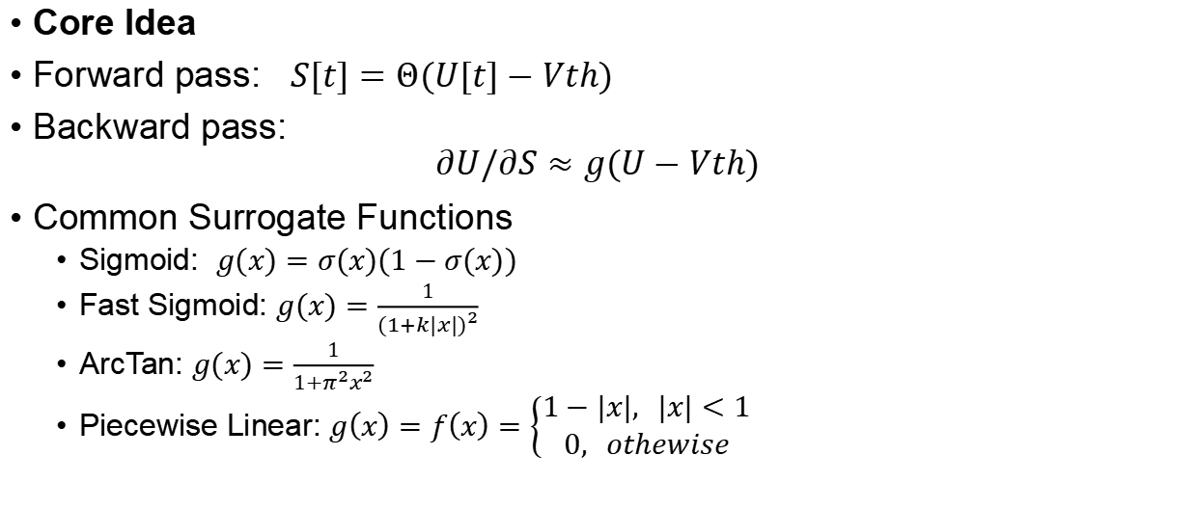
Surrogate Gradient Learning
Core Idea
Forward pass: $S[t]=Θ(U[t]−Vth)$
Backward pass:
$$∂U/∂S​≈g(U−Vth​)$$
Common Surrogate Functions
Sigmoid: $g(x)=σ(x)(1−σ(x))$
Fast Sigmoid: $g(x)=\frac{1}{{(1+k|x|)}^{2}}$
ArcTan: $g(x)=\frac{1}{1+π^{2}x^{2}}$
Piecewise Linear: $g\left(x\right)=f\left(x\right)=\left\{\begin{aligned}1−|&x|, |x|<1 \\ &0, othewise\end{aligned}\right.$
Notes:
replace the derivative of the step function with a smooth approximation
Key Insight
Forward pass remains biologically plausible.
Backward pass becomes differentiable.
Enables gradient-based optimization.

Slide 5

Sigmoid Surrogate Example
$$σ\left(x\right)=\frac{1}{1+e^{−αx}}$$
$$σ^{′}\left(x\right)=\frac{α∙e^{−αx}}{{\left(1+e^{−αx}\right)}^{2}}$$
Notes:
α 是控制曲线陡峭程度的超参数
通过调节α，模型可以在梯度的
准确性与传播的有效性之间取得平衡，从而实现SNN 的高性能训练。

Slide 6
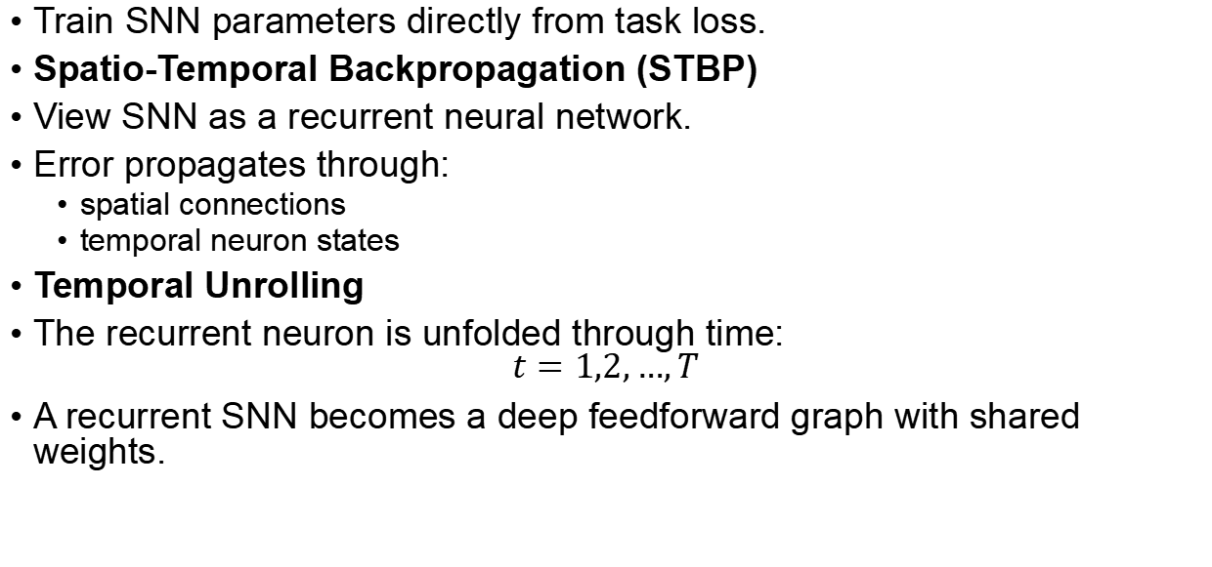
Direct SNN Training via STBP
Train SNN parameters directly from task loss.
Spatio-Temporal Backpropagation (STBP)
View SNN as a recurrent neural network.
Error propagates through:
spatial connections
temporal neuron states
Temporal Unrolling
The recurrent neuron is unfolded through time:
$$t=1,2,…,T$$
A recurrent SNN becomes a deep feedforward graph with shared weights.

Slide 7
Backpropagation Through Time (BPTT)
Unroll the network over time and accumulate gradients

Slide 8
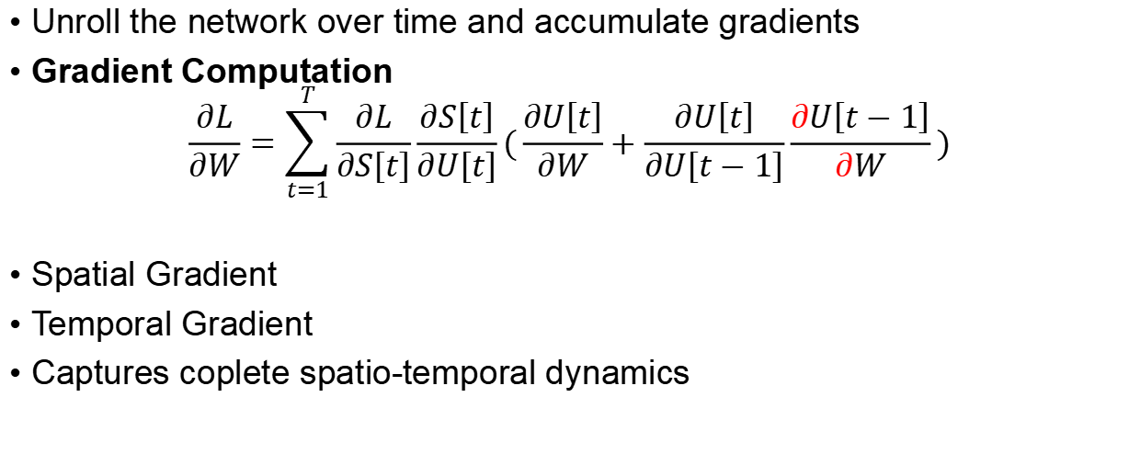
Backpropagation Through Time (BPTT)
Unroll the network over time and accumulate gradients
Gradient Computation
$$\frac{∂L}{∂W}=\sum_{t=1}^{T}{\frac{∂L}{∂S\left[t\right]}\frac{∂S\left[t\right]}{∂U\left[t\right]}}(\frac{∂U\left[t\right]}{∂W}+\frac{∂U\left[t\right]}{∂U\left[t−1\right]}\frac{∂U\left[t−1\right]}{∂W})$$
Spatial Gradient
Temporal Gradient
Captures coplete spatio-temporal dynamics

Slide 9
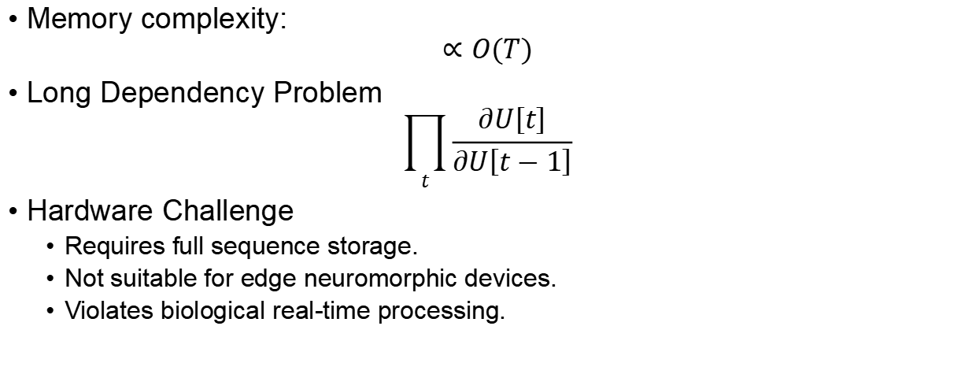
Limitations of BPTT
Memory complexity:
$$∝O(T)$$
Long Dependency Problem
$$\prod_{t}{\frac{∂U\left[t\right]}{∂U\left[t−1\right]}}$$
Hardware Challenge
Requires full sequence storage.
Not suitable for edge neuromorphic devices.
Violates biological real-time processing.
Notes:
To compute gradients:
✓ Store membrane potentials
✓ Store spikes
✓ Store computation graph
for every timestep.
Temporal dependencies are coupled across all timesteps. may cause:
vanishing gradients
exploding gradients

Slide 10
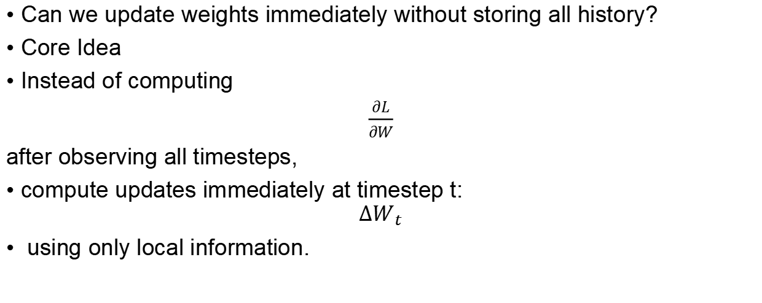
Online Learning for SNNs
Can we update weights immediately without storing all history?
Core Idea
Instead of computing
$\frac{∂L}{∂W}$
after observing all timesteps,
compute updates immediately at timestep t:
$$ΔW_{t}$$
using only local information.
Notes:
Use only local information:

Slide 11
Eligibility Trace: Replacing BPTT Memory

Slide 12
Represent Work—e-Prop

Slide 13
Represent Work—OTTT(Online Training Through Time)

Slide 14
Represent Work—NDOT(Neuronal Dynamics-based Online Training)

Slide 15
Represent Work—TESS: Temporally and Spatially Local Learning Rule for Spiking Neural Networks
Notes:
BPTT remembers every timestep and computes gradients later; Online Learning summarizes the past into an eligibility trace and updates weights immediately.

Slide 16
Represent Work—S-TLLR: STDP-inspired Temporal Local Learning Rule for Spiking Neural Networks
Notes:
BPTT remembers every timestep and computes gradients later; Online Learning summarizes the past into an eligibility trace and updates weights immediately.

Slide 18
Discussion Questions

Slide 19
Key Takeaways

